Slide 1
Principles in Leadership
Mr. Rolfe

Slide 2
Class Beaver Seating Chart room B 301
Front of the Room
Front of Room
 | Carrie | Harry
 | Mitch | Jennifer (1112)
 | Vivian | Alina
 | Wyatt | Sherry
Irene | Russell |  | Aurora | Molly
Aimee | Bob |  | Ernest | Cathy
Jackson | Catherine |  | Addy | Sid
Naomi | Vincent |  | Monica | Sonya
Vicky | Zoey |  | Tina | Wendy
Alice | Julian
Wesley | Claire
Jennifer (2328) | Ashlyn
Wanda | Shirley

Slide 3
Class Moose Seating Chart room B 303
Front of the Room
Front of Room
 | Sarah | Harold
 | William | Leticia
 | Melanie | Elijah
 | Johnson | Victor
Jacob | Elisa |  | Irene | Eligah
Minnie | Connor |  | Quincy | Andrea
Thomas | Eva |  | Lydia | Jonas
Christine | Jack |  | Ray | Heath
Lainey | Rob |  | Vivian | Hunter
Cecilia | Frank
Mark | Rebecca
Warren | Louie
Lucas | Jeremy

Slide 4
Class Raccoon Seating Chart room B 302
Front of the Room
Front of Room
 | Scott | Zoey
 | Vera (2809) | Chris (1204)
 | Alan | April
 | Carol | Sam
Christina | Oran |  | Tom | Kate
George | Irene |  | Betty | Marshall
Monica | Simon |  | Chris (3325) | Andrea
Ezra | Coco |  | Vera (2687) | Arthur
Percy | William |  | Mike | Alina
 |  |  | Howard
Vicky | Shawn
Jason | Sophia
Catherine | Albert
Hanson | Ricky

Slide 5
Class Squirrel Seating Chart room B 302
Front of the Room
Front of Room
 | Ada | Simon
 | Oliver | Alistare
 | Heidi | Stanley
 | Thomas | Emma
Johnny | Pepper |  | Philip | Zoe
Eric | Jason |  | Iesha | Finlay
Derek | Naomi |  | Frank | Marc-Andre
Sophia | Arthur |  | Nicki | Bill
 | Rick |  | Kenny | Bruce
Barry | James
Jack | Monica
Felicia | Caesar
Joey | Richard

Slide 6
Principles in Leadership Day 3
Today we are going to:
1. Sit in seats according to the new seating chart
2. Take a quiz
3. Divide into teams and discuss Team Project #1
4. Practice pronouncing the “TH” sound in English
5. Learn about small talk and practice

Slide 7
Put your cellphone on your desk where I can see it and only use it in class to look up something you don’t understand or to take a photo of ppt.

Slide 8

Homework Check
Did you greet an English speaker? I may ask you questions about it, so please be ready!

Slide 9
Meet your new partner!
Introduce yourself to your new partner using the greetings we have learned last week. Check your notes if you need to remember them.

Slide 10
Teams for Team Projects BEAVER
Team 1: Carrie, Harry, Mitch, Jennifer (1112) and Alina
Team 2: Vivian, Wyatt, Sherry, Naomi and Vicky
Team 3: Irene, Russell, Aimee, Bob and Catherine
Team 4: Jackson, Vincent, Zoey, Monica, Tina and Wendy
Team 5: Aurora, Molly, Ernest, Cathy and Addy
Team 6: Alice, Julian, Wesley, Claire and Jennifer (2328)
Team 7: Sid, Sonya, Ashlyn, Wanda and Shirley

Slide 11
Teams for Team Projects MOOSE
Team 1: Sarah, Harold, William, Leticia and Elijah
Team 2: Melanie, Johnson, Victor, Christine and Jack
Team 3: Jacob, Elisa, Minnie, Connor and Thomas
Team 4: Irene, Eligah, Quincy, Andrea and Jonas
Team 5: Eva, Lydia, Ray, Lainey, Heath and Rob
Team 6: Cecilia, Frank, Mark , Rebecca and Louie
Team 7: Warren, Lucas, Jeremy, Vivian and Hunter

Slide 12
Teams for Team Projects RACCOON
Team 1: Scott, Zoey, Vera (2809), Chris (1204) and April
Team 2: Alan, Sam, Carol, Ezra and Monica
Team 3: Christina, Oran, George, Irene and Simon
Team 4: Tom, Kate, Betty, Marshall and Chris (3325)
Team 5: Coco, Percy, William, Vera (2687), Howard and Mike
Team 6: Vicky, Shawn, Jason, Sophia and Catherine
Team 7: Andrea, Arthur, Alina, Albert, Hanson and Ricky

Slide 13
Teams for Team Projects SQUIRREL
Team 1: Ada, Simon, Oliver, Alistare and Heidi
Team 2: Stanley, Thomas, Emma, Sophia and Derek
Team 3: Johnny, Pepper, Eric, Jason and Naomi
Team 4: Philip, Zoe, Iesha, Finlay and Frank
Team 5: Marc-Andre, Arthur, Nicki, Rick and Kenny
Team 6: Barry, James, Jack, Monica and Caesar
Team 7: Felicia, Joey, Richard, Bill and Bruce

Slide 14
Team Project #1 – Canteen Menus
Your team will be given a window of one of the canteens and you will be responsible to make a menu for that window, following the format of the menu you are given. The menu must include:
1. The name of the dish in Chinese
2. The name of the dish in pinyin
3. The name of the dish in English
Your group must begin by choosing a leader for the project. Remember that ALL of you will lead one project this semester. After you have been assigned your Canteen windows, get in your teams for the next five minutes and discuss ideas about how you will accomplish the task.
Your team has two weeks to complete this project!! The menu will need to be turned in as a Word document file, and as a printed version.

Slide 15
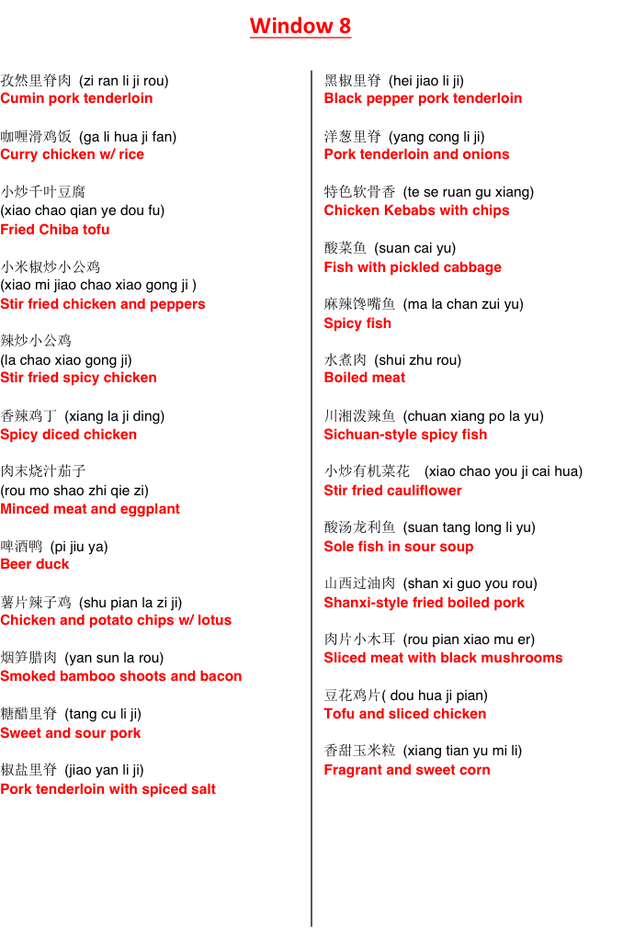
Menu Format
The window number should be centered at the top. Each item of the menu must have the Chinese name, the Chinese name in pinyin and the English name describing the item. The layout should be in columns, with section headings when necessary.

Slide 16
Team Project #1 assignments BEAVER
Team 1 – window 1 (North Canteen 3rd Floor)
Team 2 – window 4 (North Canteen 3rd Floor)
Team 3 – window 5 (North Canteen 3rd Floor)
Team 4 – window 6 (North Canteen 3rd Floor)
Team 5 – counter with drinks (North Canteen 3rd Floor)
Team 6 – window 3 (South Canteen 3rd Floor)
Team 7 – window 4 (South Canteen 3rd Floor)
All windows are on the third floor of the North or South Canteens. Some of the menus for the windows have changed. If they already have menus, you need to compare the English menu from last year and make sure that it is completely accurate. If it is not, then you must make the changes so that it is correctly updated. Remember that these menus are for international students and foreign teachers.

Slide 17
Team Project #1 – Student Store Menus
Your team will be given one of the food stores along the back of the Student Store in the basement and you will be responsible to make a menu for that store, following the format of the menu you are given. The menu must include:
1. The name of the dish in Chinese
2. The name of the dish in pinyin
3. The name of the dish in English
Your group must begin by choosing a leader for the project. Remember that ALL of you will lead one project this semester. After you have been assigned your food store, get in your teams for the next five minutes and discuss ideas about how you will accomplish the task.
Your team has two weeks to complete this project!! The menu will need to be turned in as a Word document file, and as a printed version.

Slide 18
Menu Format
The window number should be centered at the top. Each item of the menu must have the Chinese name, the Chinese name in pinyin and the English name describing the item. The layout should be in columns, with section headings when necessary.

Slide 19
Team Project #1 assignments MOOSE
Team 1 – window 10 (South Canteen 3rd Floor)
Team 2 – window 12 (South Canteen 3rd Floor)
Team 3 – window 16 (South Canteen 3rd Floor)
Team 4 – window/drink bar (South Canteen 3rd Floor)
Team 5 – Bubble Tea Shop (back of Student Store)
Team 6 – BBQ and Chuan Store (back of Student Store)
Team 7 – BBQ and Rice Store (back of Student Store)
The menus are for the food stores in the Student Store along the back wall, going from right to left. You must complete accurate menus for each menu in the windows using the format given to your team leader. You must also communicate with the managers of the windows to see if they will use the menu. Remember that these menus are for international students and foreign teachers.

Slide 20
Team Project #1 assignments RACCOON
Team 1 – Pancake Store (back of Student Store)
Team 2 – Bing and Wrap Store (back of Student Store)
Team 3 – Korean Food Store (back of Student Store)
Team 4 – Rice Bowl Store (back of Student Store)
Team 5 – Noodles and Fish Soup Store (back of Student Store)
Team 6 – Sushi Store (back of Student Store)
Team 7 – Fake KFC Store (back of Student Store)
The menus are for the food stores in the Student Store along the back wall, going from right to left. You must complete accurate menus for each menu in the windows using the format given to your team leader. You must also communicate with the managers of the windows to see if they will use the menu. Remember that these menus are for international students and foreign teachers.

Slide 21
Team Project #1 – Coffee Shop Menus
Your team will be given one of the coffee shops on campus and you will be responsible to make a menu for that shop that will fit on one piece of paper (1 or 2 sided). The menu must include:
1. The name of the dish in Chinese
2. The name of the dish in pinyin
3. The name of the dish in English
Your group must begin by choosing a leader for the project. Remember that ALL of you will lead one project this semester. After you have been assigned your coffee shop, get in your teams for the next five minutes and discuss ideas about how you will accomplish the task.
Your team has two weeks to complete this project!! The menu will need to be turned in as a Word document file, and as a printed version.

Slide 22
Team Project #1 assignments SQUIRREL
Team 1 – Building 1 Coffee Shop (just drinks made there)
Team 2 – Building 1 Coffee Shop (just drinks made there)
Team 3 – Building 2 Coffee Shop
Team 4 – Building 2 Coffee Shop
Team 5 – Library Coffee Shop
Team 6 – Library Coffee Shop
Team 7 – Library Coffee Shop
These coffee shops have menus posted for the products they make and serve. You need to create a menu they can use that follows the format given to your team leader. Also, you must communicate with the managers of the coffee shops to see if they will use the English menu. The best menu design will be offered to the shops. Remember that these menus are for international students and foreign teachers.

Slide 23
Team Project #1 – Package Delivery Posters
Your team must begin by choosing a leader for the project. Remember that ALL of you will lead one project this semester. Something that is difficult for new international students and teachers to learn are the steps for retrieving a package from the different places around campus. Your team must design a poster that will show at the least, step-by-step, the way to read an SMS from the sender as to where to go, what machines to use, what buttons to push and what code is needed.
Your team will have two weeks to complete this project!! The poster must be turned in both as a pdf and word doc file, and a printed copy.

Slide 24
Team Project #1 assignment FOX
Each team is required to design and print a poster that will guide an international student or foreign teacher through the steps needed to retrieve a package in the Danfeng basement. The best poster will be posted on the wall in Danfeng.

Slide 25
Team Project #1 assignment POLAR BEAR
Each team is required to design and print a poster that will guide an international student or foreign teacher through the steps needed to retrieve a package in the Boya basement. The best poster will be posted on the wall in Boya.

Slide 26
Let’s take a 5 minute break!

Slide 27
Pronunciation of the “Th” Sound
The “Th” sound in English is made by placing the tip of your tongue between your teeth, and blowing air out. It will feel uncomfortable at first, but with practice it will become easier.
I think his thirteenth birthday is on Thursday.
Throughout history, there have been thinkers and there have been doers.
My father and mother are both fifty-three.

Slide 28
Small Talk
“Hello, how are you?”
This common greeting among people is NOT a true, sincere question asking about the details of your life. It is what is known as “small talk” in the West. Small talk is the practice of casual, superficial conversation with someone you do not know well. It provides a platform for interaction that allows for two people to get to know each other better without a commitment to any more future relationship.
“ I am fine, thank you. How are you?”

Slide 29
Passing a conversation back and forth
Think of a good conversation like a friendly ping pong game. You want the ball to be hit to you, but then you want to nicely hit it back to your partner.
Remember that a conversation should not be “one-sided.” If you do all of the talking in a conversation, then it is like grabbing the ball when it comes to you and holding it.
A casual conversation is also not a competition to be won. Talking about inappropriate topics is like spiking the ball.

Slide 30
What to Talk About
There are many subjects that can be discussed in a casual conversation during small talk:
The weather
Sports or Hobbies
Where are you from?
What do you do for work / what are you studying?
Compliment their clothes
Have you ever been to….?

Slide 31
What Not to Talk About
There are some topics that are considered inappropriate to discuss in the West and rude to ask about:
Politics
Religion
Salary
Health: weight, height, illnesses, etc.
Details about personal life and family members

Slide 32
Sentence Stems
In small talk, it is good to know a few appropriate ways to bring up topics. Here are some sentence stems that you can memorize for use in small talk. Think of sentence stems as branches that different leaves (different topics) can grow from.
“Have you ever been to…?”
“What’s your favourite…?”
“Do you know how to….?”
“Do you like…?
“What do you think about…?
(Choose the topic carefully!)

Slide 33
You’re at a Party
Using the paper that Mr. Rolfe gives you, find the people with the same number as you and begin to engage in small talk with someone in the group. When Mr. Rolfe says switch, find the people with the next number on the paper and start again. Repeat this four times.

Slide 34
Homework
Read and complete the exercises for Days 1 and 2 in the textbook Modern Leadership Strategies from Ancient Chinese Wisdom.
Meet with your team and work on the team project #1. It is due in two weeks!
Greet Mr. Rolfe and other foreign teachers with the appropriate greetings we have practiced whenever you see them on campus.

